Slide 1


Rudolf Horvat
22.1.2023

Slide 2

Outline
Executive Summary
Introduction
Methodology
Results
Conclusion
Appendix

Slide 3
Executive Summary
Summary of methodologies
Summary of all results

Slide 4
Introduction
Project background and context
Problems you want to find answers

Slide 5

Section 1

Slide 6
Methodology
Executive Summary
Data collection methodology:
Spacex has published launch related data on their website
The data is made available in form of a JSON file from the following public URL https://api.spacexdata.com/v4/launches/past
Perform data wrangling
Missing PlayloadMass dana was replaced with the mean value
Perform exploratory data analysis (EDA) using visualization and SQL
Perform interactive visual analytics using Folium and Plotly Dash
Perform predictive analysis using classification models
Four classification models where fitted, the best model was selected based on crossvalidation and hyperparameter tuning

Slide 7
Data Collection
Data in the form of a JSON file was downloaded from the spacex
REST API at https://api.spacexdata.com/v4/launches/past
The data was processed as described in slide Data Collection – SpaceX API
Wikipedia website
The data was processed as described in slide Data Collection - Scraping

Slide 8
Data Collection – SpaceX API
GitHub URL: capstone/data-collection.ipynb at master · rhorvatgm/capstone (github.com)
Define helper functions that convert Ids tonames
Download dana from REST API
Convert dana to DataFrame
Convert Ids to Names
Filter dataframe to include only Falcon 9 launch data
Deal with missing dana (eg. Convert missing values to mean)

Slide 9
Data Collection - Scraping
GitHub URL: capstone/webscraping.ipynb at master · rhorvatgm/capstone (github.com)
Download HTML table from Wikipedia
Create Beautifull soup object
Convert to pandas dataframe
Extract column names
Parse data

Slide 10
Data Wrangling
Describe how data were processed
You need to present your data wrangling process using key phrases and flowcharts
Add the GitHub URL of your completed data wrangling related notebooks, as an external reference and peer-review purpose

Slide 11
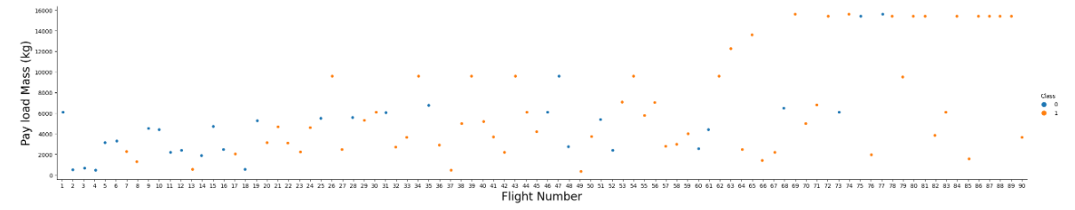
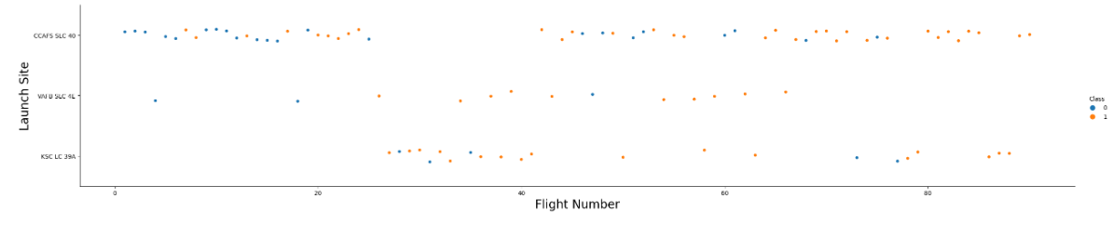
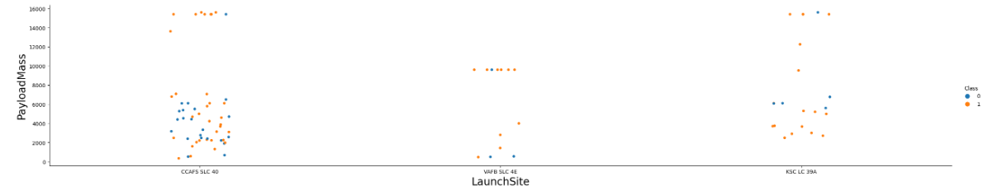
EDA with Data Visualization
GitHub URL: capstone/eda-visualization.ipynb at master · rhorvatgm/capstone (github.com)
Several charts were plotted
Flight no vs playload – to analyze how playload was increased and how success rate (indicated by datapoint color) depended on flight no and playload
Flight no vs Launch site
Launch site vs Payload mass

Slide 12
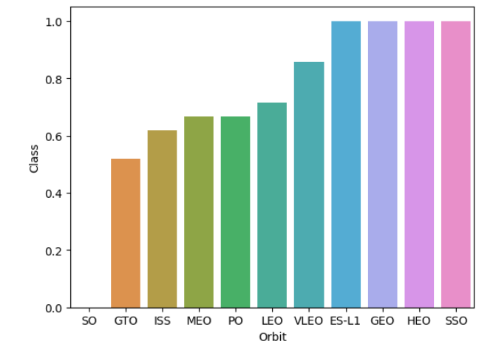
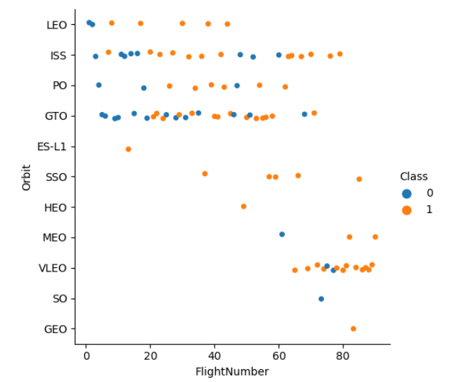
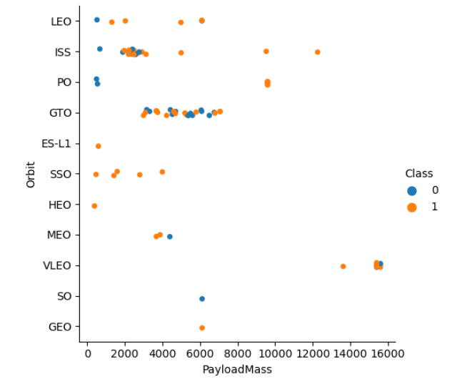
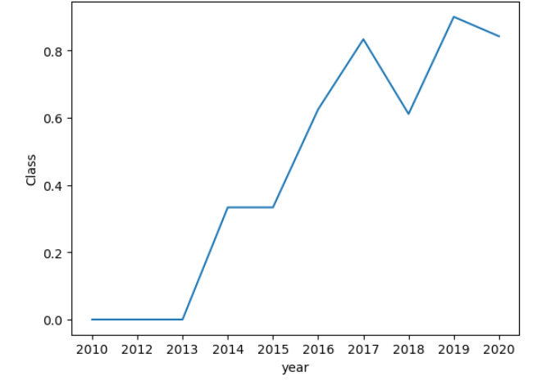
EDA with Data Visualization (continued)
Several charts were plotted (continued)
Orbit vs Success rate
Flight no vs Orbit
Payload mass vs Orbit
Success rate over time

Slide 13
EDA with SQL
Github URL: capstone/eda-sql.ipynb at master · rhorvatgm/capstone (github.com)
Following SQL queries were performed:
Unique launch sites
5 records where launch sites begin with the string 'CCA’
total payload mass carried by boosters launched by NASA (CRS)
average payload mass carried by booster version F9 v1.1
date when the first successful landing outcome in ground pad was acheived.
names of the boosters which have success in drone ship and have payload mass greater than 4000 but less than 6000
total number of successful and failure mission outcomes
names of the booster_versions which have carried the maximum payload mass
he failed landing_outcomes in drone ship, their booster versions, and launch site names for in year 2015
Rank the count of landing outcomes (such as Failure (drone ship) or Success (ground pad)) between the date 2010-06-04 and 2017-03-20, in descending order

Slide 14
Build an Interactive Map with Folium
GitHub URL: capstone/interactive_visual.ipynb at master · rhorvatgm/capstone (github.com)
The following dana was visualized in a form of an interactive map:
Launch sites
Number of launches per size along with color indication of the landing outcome. Markers were clustered because the same launch site was used for several launches
The distances to proximities (railroad, roads, coastline) were calculated and displayed

Slide 15
Build a Dashboard with Plotly Dash
Github URL: capstone/spacex_dash_app.py at master · rhorvatgm/capstone (github.com)
An interactive dashboard application was created. The use is able to select the launch site and filter the playload mass range
The results are accordingly updated and displayed in a
Piechart format (success rate) and
Scatter plot (playload mass vs landing outcome)

Slide 16
Predictive Analysis (Classification)
First the data was normalized
Four classification models were chosen
Logistic regression, support vector machine, decision tree and k nearest neighbours
The dana was split into training and test dana
Hyper parameters where chosen using Gridsearch and crossvalidation with 10 folds
The accuracy was tested using the best hyperparameters on the test data
Load data
Standardize
Train/test split
Hyperparameter optimization for each model
Evaluation based on accuracy on test dana
Best model chosen

Slide 17
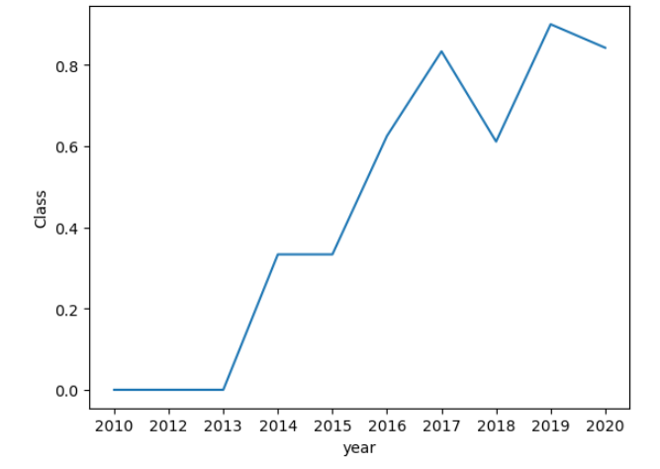
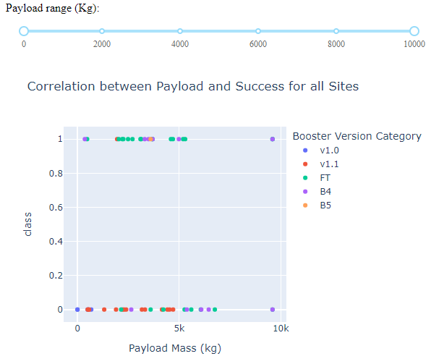
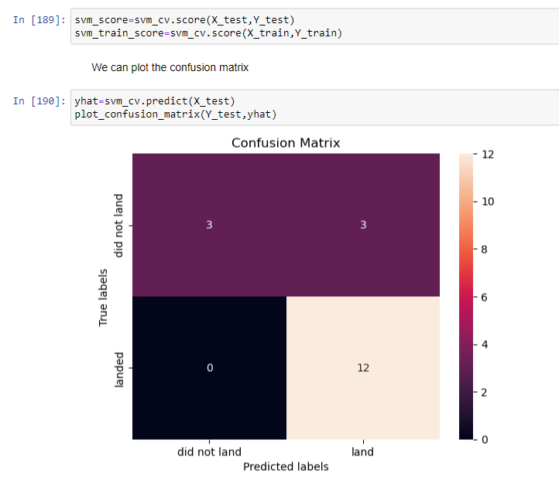
Results
Exploratory data analysis results
Successful landings improved over time
Success rate variwes over playload mass
We can predict the landing outcome with a Support vector machine and 83,3% accuracy

Slide 18

Section 2

Slide 19
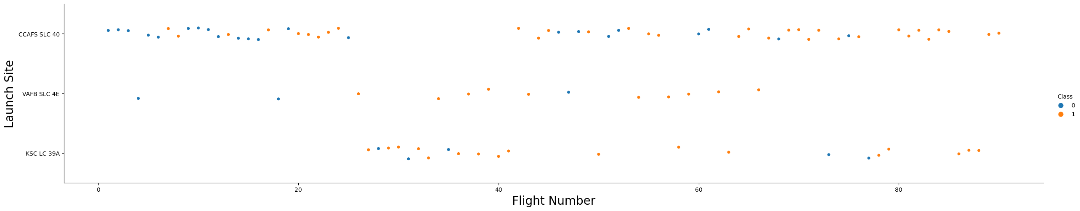
Flight Number vs. Launch Site
For the first 25 flights mainly the launch site CCAFS SLC 40 was used
The use of launch site KSC LC 39A was intensified between launch attempts 27 to 41
Overall, the launch site CCAFS SLC 40 was the most used one

Slide 20
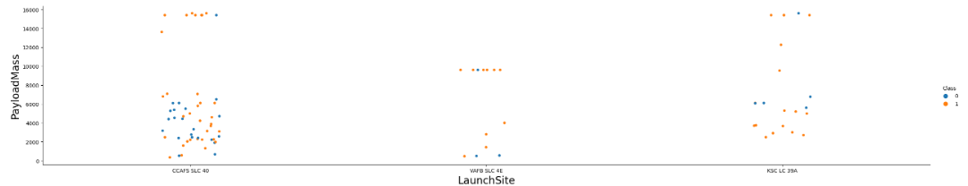
Payload vs. Launch Site
Most of the low payload (<= 8k kg) launches where conducted from launch site CCAFS SLC 40
Launch site VAFB SLC 4E was not used for high payload, bud intesnivelly used for payloads aroud 10k kg
Most of the high payloads (>=14k kg) were launched from CCAFS SLC 40

Slide 21
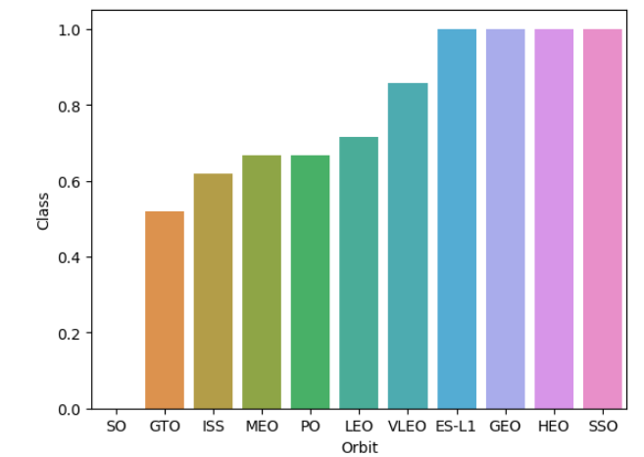
Success Rate vs. Orbit Type
Success rate varies over different orbits
There were no successfull landings after a launch attempt to orbit SO
Successfull landing rates for orbits GTO, ISS, MEO, PO, LEO, VLEO stepwise rise from 50% to 85%
The landings of launches to orbits ES-L1, GEO, HEO and SSO were 100% successfull

Slide 22
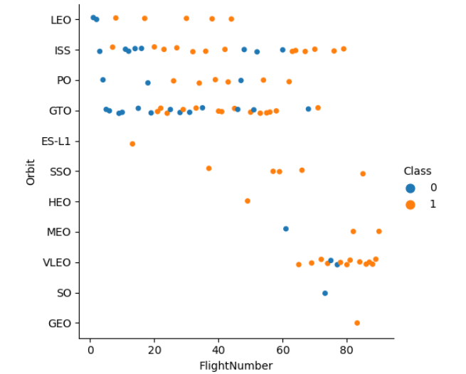
Flight Number vs. Orbit Type
The most targeted orbits in the first 70 flights were LEO, ISS, PO and GTO
Later on VLEO was the most targeted orbit
The success rate of launches targeting SSO is 100%
Overall success rate improved over time

Slide 23
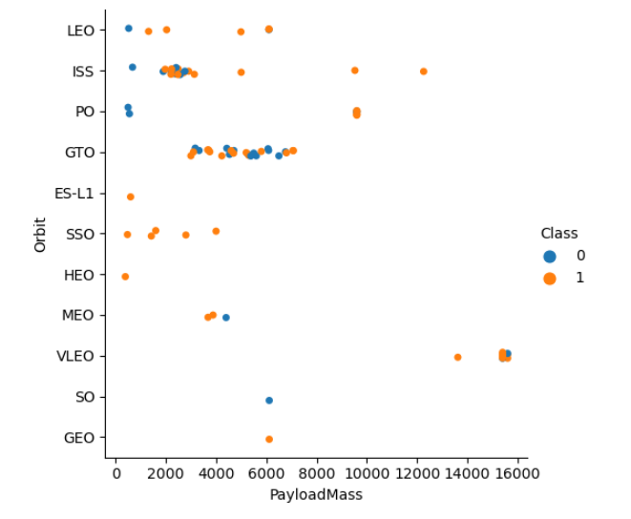
Payload vs. Orbit Type
Show a scatter point of payload vs. orbit type
Show the screenshot of the scatter plot with explanations

Slide 24
Launch Success Yearly Trend
The success rate generally rises over time
In 2019-2020 it’s over 80%

Slide 25
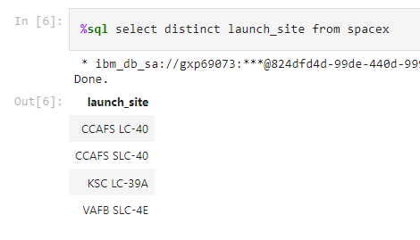
All Launch Site Names
Four different launch site names were present in the datase
Three of them (CCAFS LC-40, CCAFS SLC-40, KSC LC-39A) in Florida, one (VAFB SLC-4E) in California

Slide 26
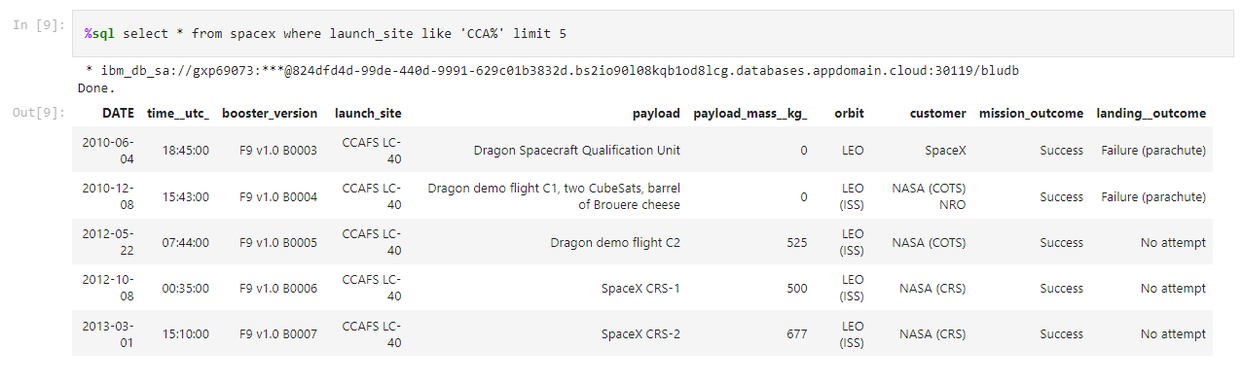
Launch Site Names Begin with 'CCA'
Here are 5 records where launch sites begin with `CCA’
All 5 attempts were conducted to the low Earth orbit

Slide 27
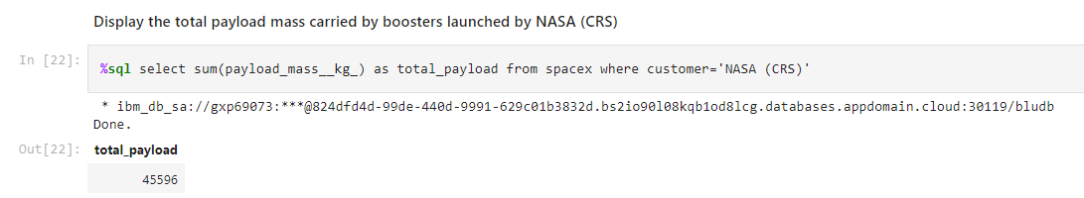
Total Payload Mass
The total payload carried by boosters from NASA was 45596 kg

Slide 28
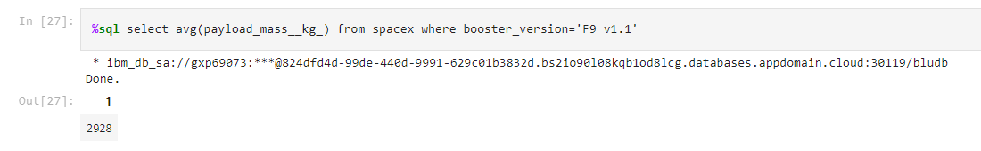
Average Payload Mass by F9 v1.1
The average payload mass carried by booster version F9 v1.1 was 2928 kg

Slide 29
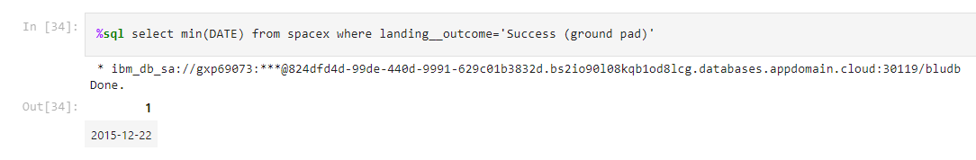
First Successful Ground Landing Date
The date of the first successful landing outcome on ground pad was dec 22 2015

Slide 30
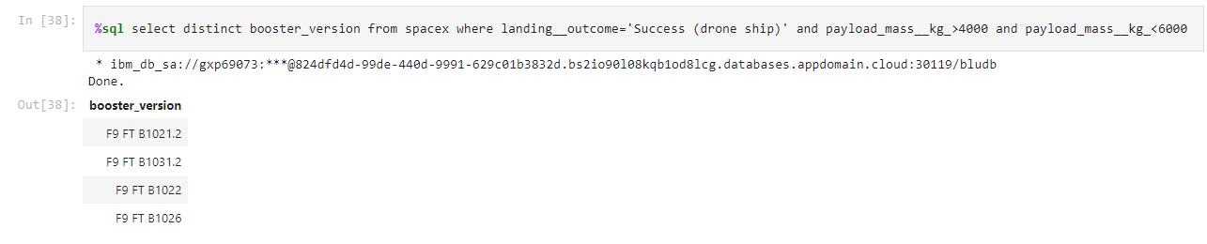
Successful Drone Ship Landing with Payload between 4000 and 6000
The names of boosters which have successfully landed on drone ship and had payload mass greater than 4000 but less than 6000:

Slide 31
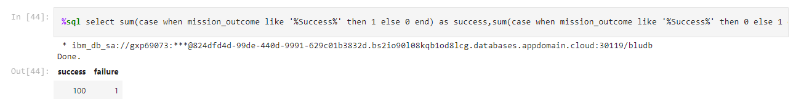
Total Number of Successful and Failure Mission Outcomes
The total number of successful mission outcomes was 100
There was only one unsuccessfull mission outcome

Slide 32
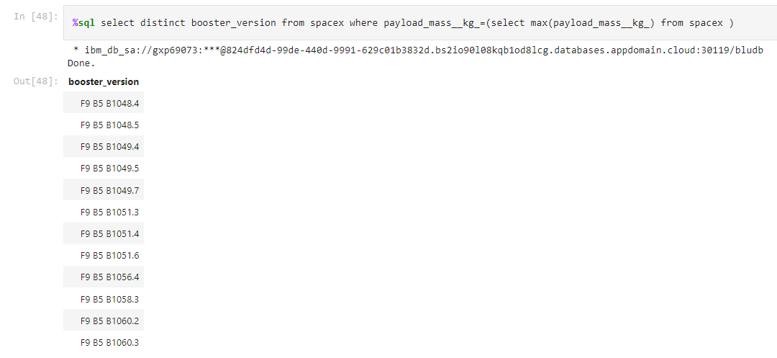
Boosters Carried Maximum Payload
Here is a list of the boosters which have carried the maximum payload mass

Slide 33
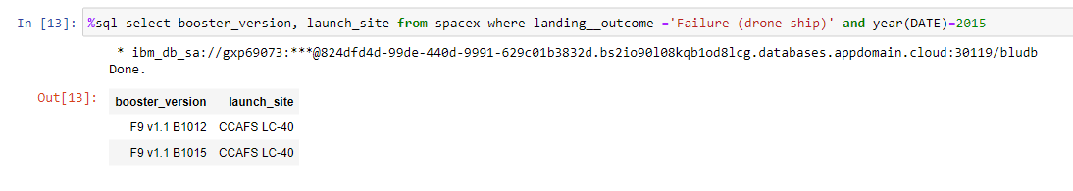
2015 Launch Records
Here is a list of failed landing_outcomes in drone ship, their booster version, and launch site names in year 2015

Slide 34
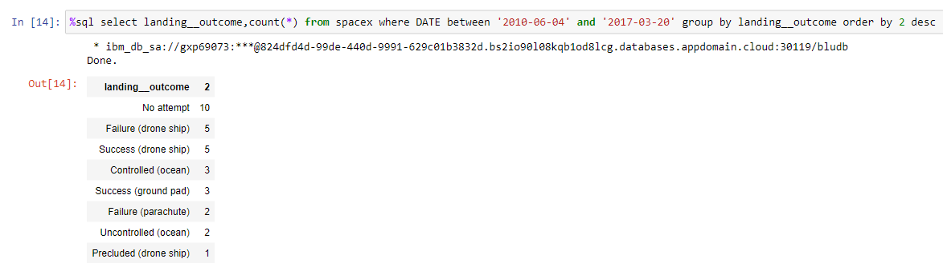
Rank Landing Outcomes Between 2010-06-04 and 2017-03-20
Here are the landing outcomes (such as Failure (drone ship) or Success (ground pad)) between the date 2010-06-04 and 2017-03-20, in descending order of incidence

Slide 35

Section 3

Slide 36
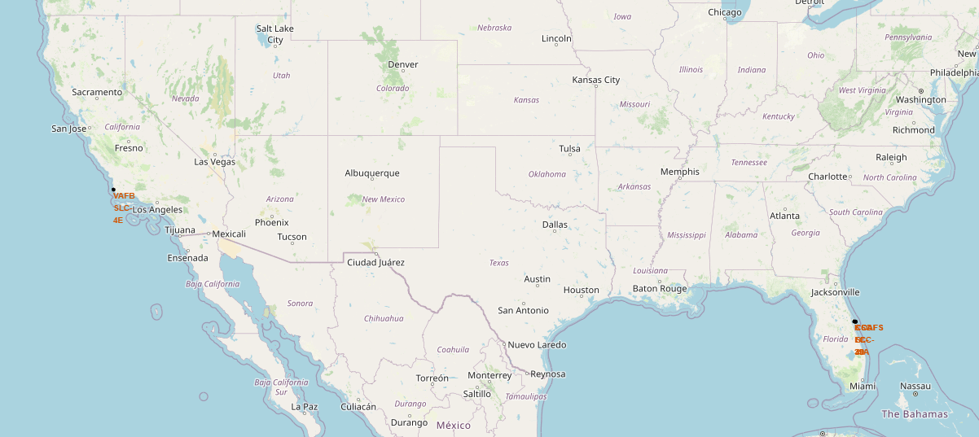
SpaceX launch sites
There are 4 launch sites, one in California and three in Florida

Slide 37
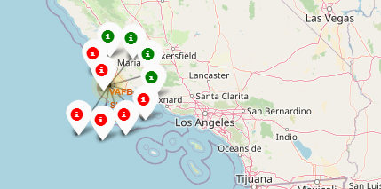
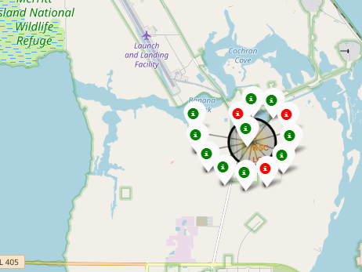
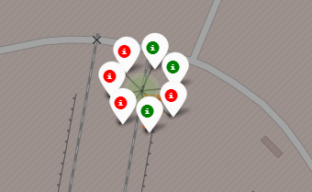
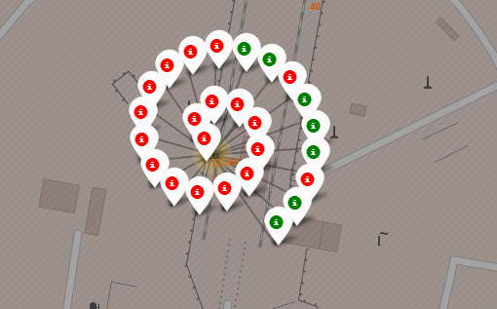
Outcomes maped by launch sites
California VAFB SLC-4E: 4 sucesses out of 10
Florida KSC LC-39A: 11 sucesses out of 13 – best success rate
Florida KSC LC-39A: 3 sucesses out of 7
Florida CCAFS LC-40: 7 sucesses out of 26, most used launch site

Slide 38
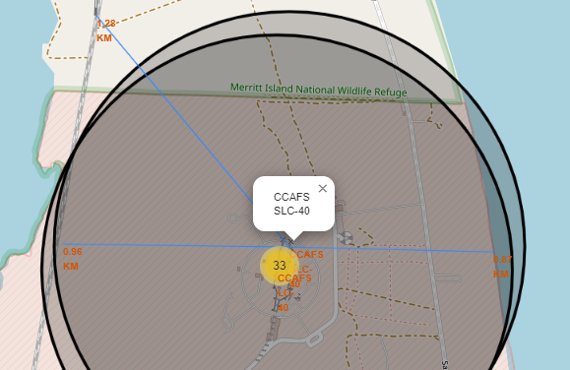
Launch site CCAFS SLC-40 air distance to proximities
The air distance to the coastline is aprox. 0.87 km
The air distance to the NASA railroad is aprox. 1.28 km
The air distance to TITAN III Road is aprox. 0.96 km

Slide 39

Section 4

Slide 40
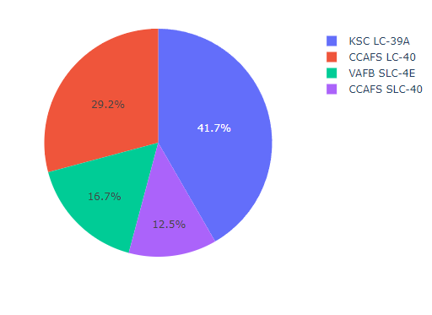
Successfull launches per site
Most of the successfull launches were conducted from KSC LC-39A and CCAFS LC-40.
Together these sites account for more then 70% of the successfull attemts.

Slide 41
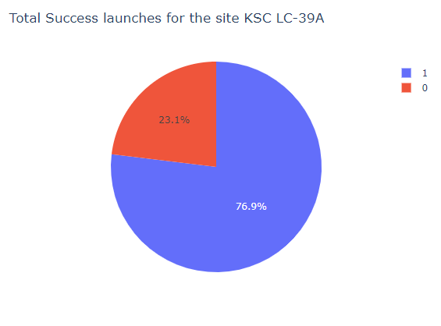
Launch site KSC LC-39A Success rate
76,9% of the launches from site KSC LC-39A have successfully landed

Slide 42
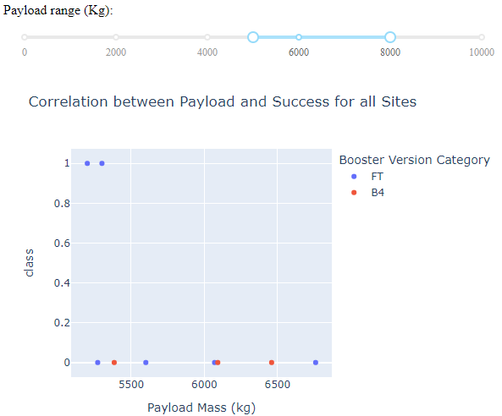
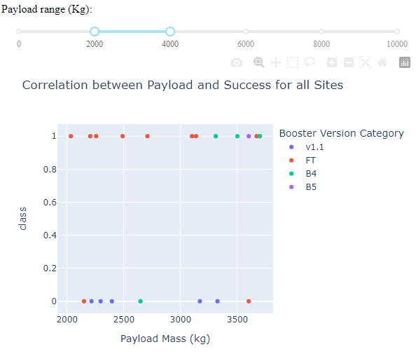
Correlation between Payload and Success
The success rate varies over different payload ranges
Most of the attempts with payload between 5k and 8k kg have not finished with sucessfull landings
Payloads between 2k and 4k kg have above average success rate

Slide 43

Section 5

Slide 44
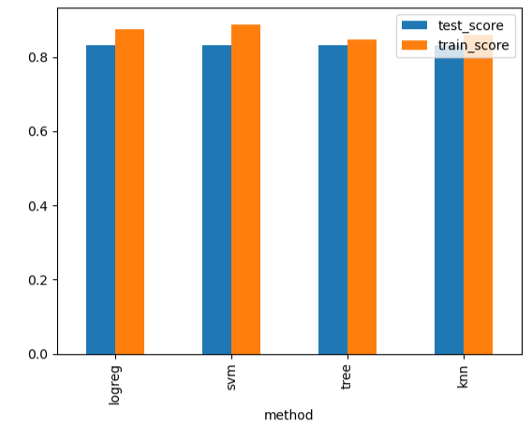
Classification Accuracy
The support vector machine model had the highest accurary on the training data, but
all models had the same accuracy (83.3%) on the test data

Slide 45
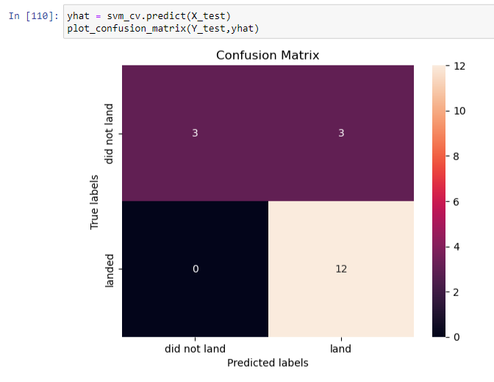
Confusion Matrix
The overall accuracy of the model on the training set is 83,3%

Slide 46
Conclusions
All models preformed equally on the test dana, even more
All confusion matrixes were equal
The accuracy was 83,3%
There were no false negative predictions, but there
Were false positive predictions

Slide 47
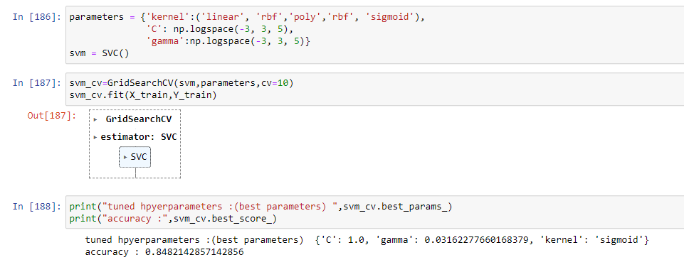
Appendix
Here’s the code for the SVM model

Slide 48
Appendix (continued)

Slide 49
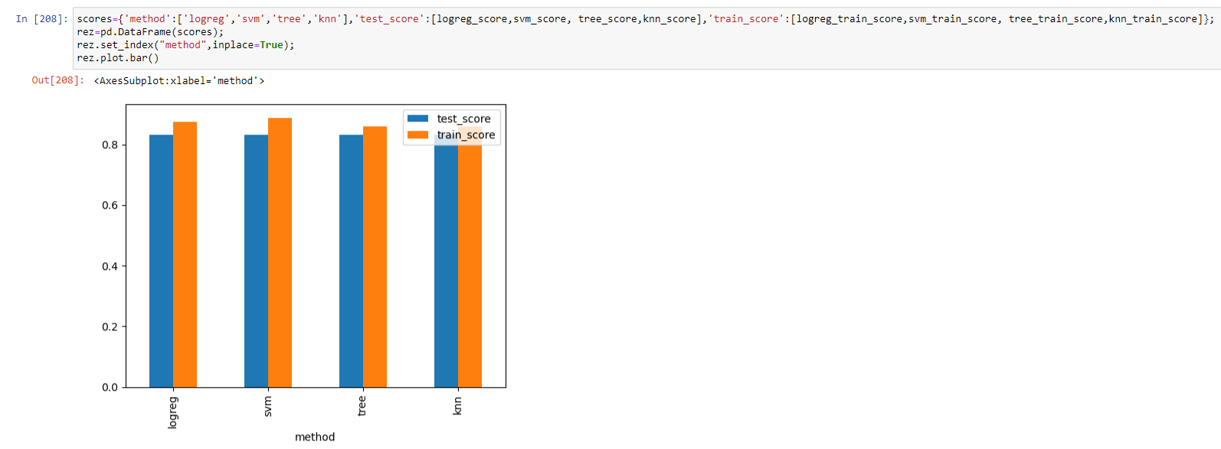
Appendix (continued)
Model comparison

Slide 50


